Slide 1
Introduction to IPv6/IPng
New version of IP
Replaces IPv4 (due to exhaustion of available IPv4 address space)
Many new features added
Critical Improvements
TCP/IP Protocol Suite

Slide 2
Limitations of IPv4
Does not handle the address space for ever growing internet.
Due to exponential growth of internet is unable to support huge increase in the number of users or the geographical need of the internet expansion.
IPv4 address depletion, was forseen as approaching,and has approached.
Additional Emerging applications – PDAs, HANs,mobile addhoc network,IP wireless services,Integrated IP telephony services require a new Internet Protocol
TCP/IP Protocol Suite

Slide 3
Lifetime of IPv4 extended .
NAT
CIDR (& Subnetting)
DHCP
IPv4 is inadequate for-
Network & user mobility
Always-on environment
Plug and play protocol requirements
TCP/IP Protocol Suite

Slide 4
IPv6 benefits
Larger address space
Global addresses for each network device
Enables end-to-end reachability
Almost unlimited number of IP addresses
128 bits size
340 undecillion address (3.4 x 10 exp 37)
TCP/IP Protocol Suite

Slide 5
Simplified Header format
For efficient packet handling
Some fields removed & some renamed & some intact.
Hiearchical network architecture for better routing efficiency which follows some CIDR principles.
Embedded Security – mandatory IPSec implementation in each IPv6 node.
TCP/IP Protocol Suite

Slide 6
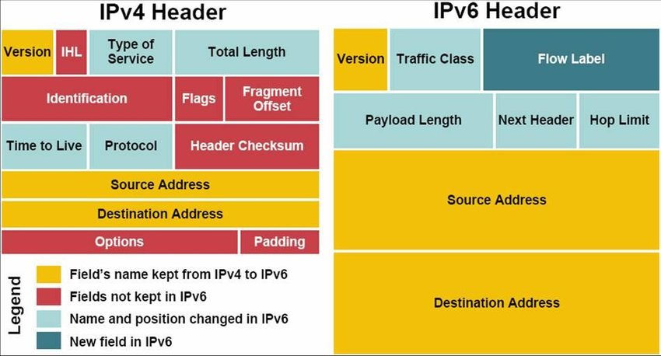
TCP/IP Protocol Suite

Slide 7
Support for more number of Multicast addresses,
And broadcast not supported hence leading to better performance network.
ICMP replaced with ICMPv6
ICMPv6 supports autoconfiguration,neighbour discovery,multicasting.
Supports Built-in mobility.
TCP/IP Protocol Suite

Slide 8
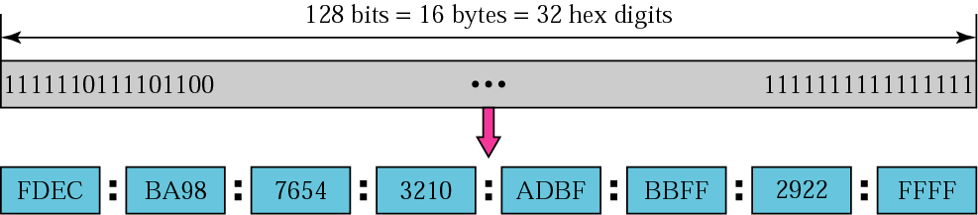
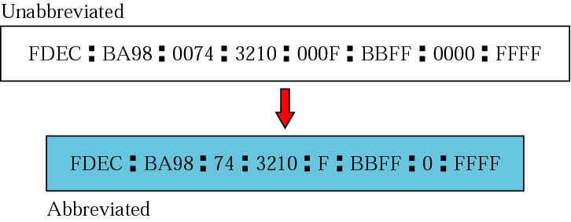
Figure IPv6 address
TCP/IP Protocol Suite

Slide 9
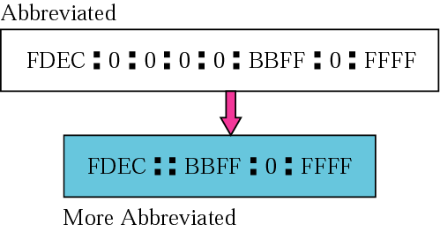
Figure Abbreviated address with consecutive zeros
TCP/IP Protocol Suite

Slide 10
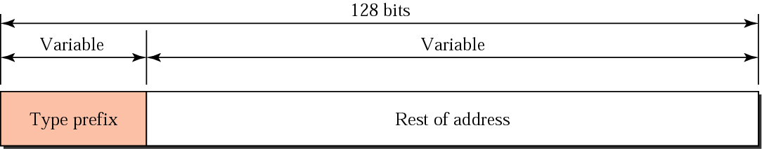
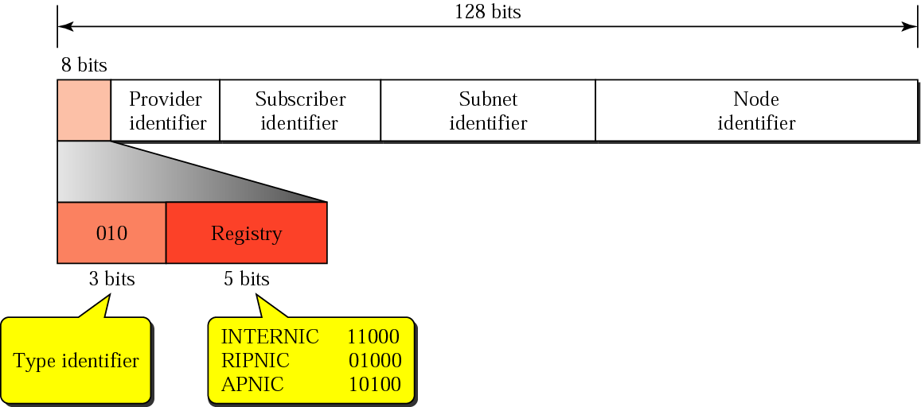
Figure Address structure
Figure Provider-based address
TCP/IP Protocol Suite

Slide 11
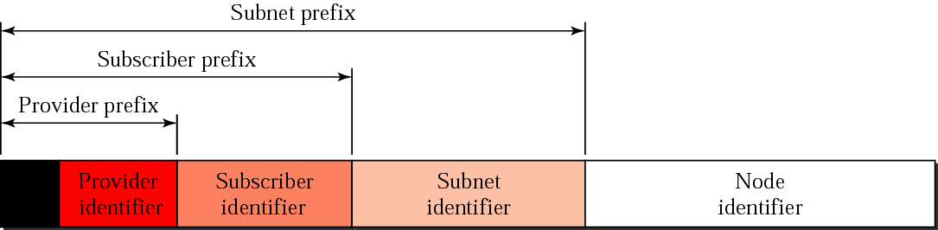

Figure Address hierarchy
Figure Unspecified address (equivalent to 0.0.0.0 in IPv4)
TCP/IP Protocol Suite

Slide 12

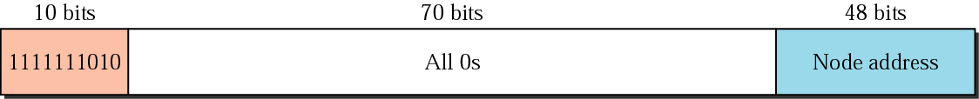
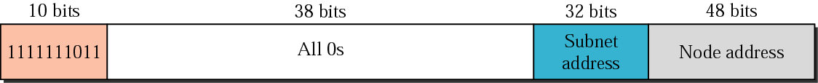
Figure Loopback address
Figure Link local address (equivalent to APIPA in IPv4 169.254.0.1 to 169.254.255.254)
Figure Site local address(are equivalent to private IP addresses in IPv4)
TCP/IP Protocol Suite

Slide 13
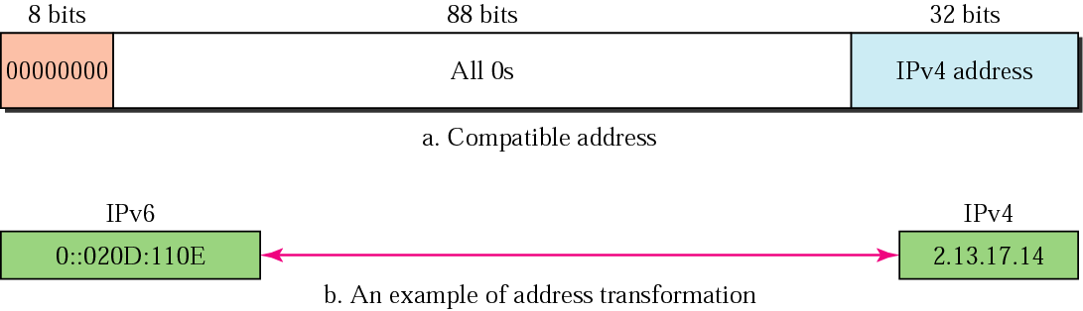
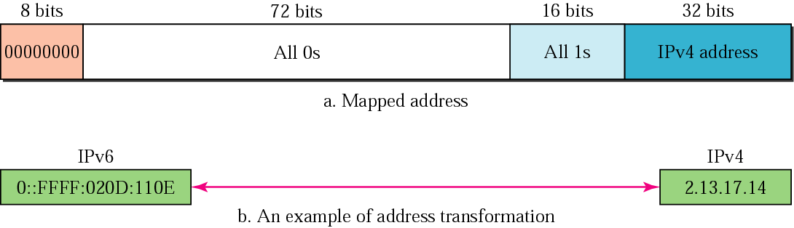
Figure Compatible address(This format enables you to configure an IPv6 node to use IPv6 without having a real IPv6 address)
Figure Mapped address(IPv6 has a special range designed to represent an IPv4 IP address but in a form similar to IPv6. This range is known as the IPv4-mapped IPv6 address.)
TCP/IP Protocol Suite

Slide 14
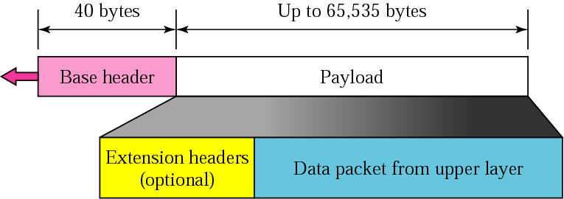
Figure IPv6 datagram
TCP/IP Protocol Suite

Slide 15
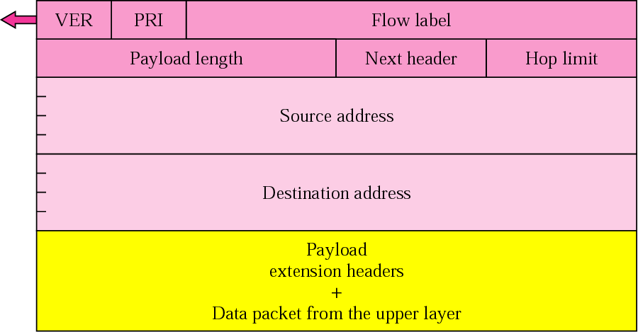
Figure Format of an IPv6 datagram
TCP/IP Protocol Suite

Slide 16
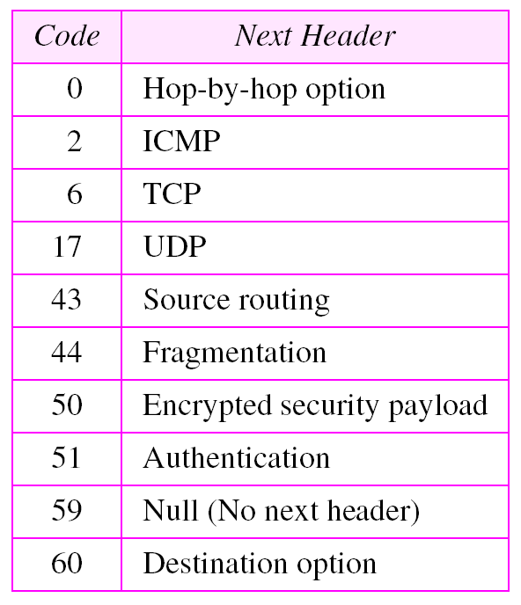
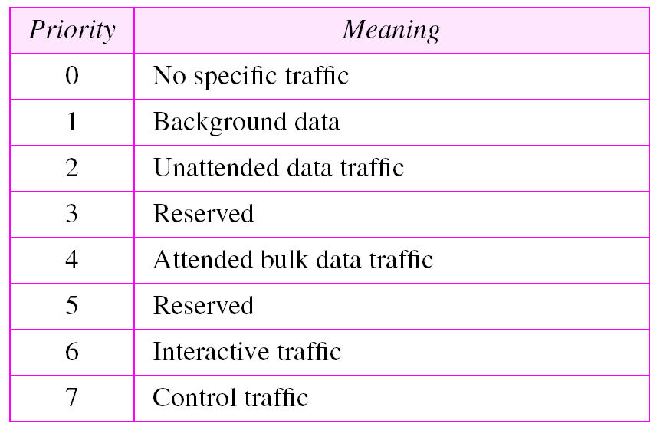
Table Next header codes
Table Priorities for congestion-controlled
traffic
TCP/IP Protocol Suite

Slide 17
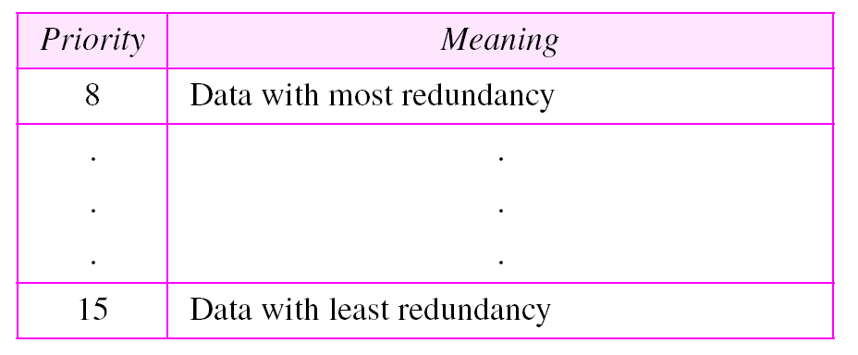
Table Priorities for noncongestion-controlled
traffic
TCP/IP Protocol Suite

Slide 18
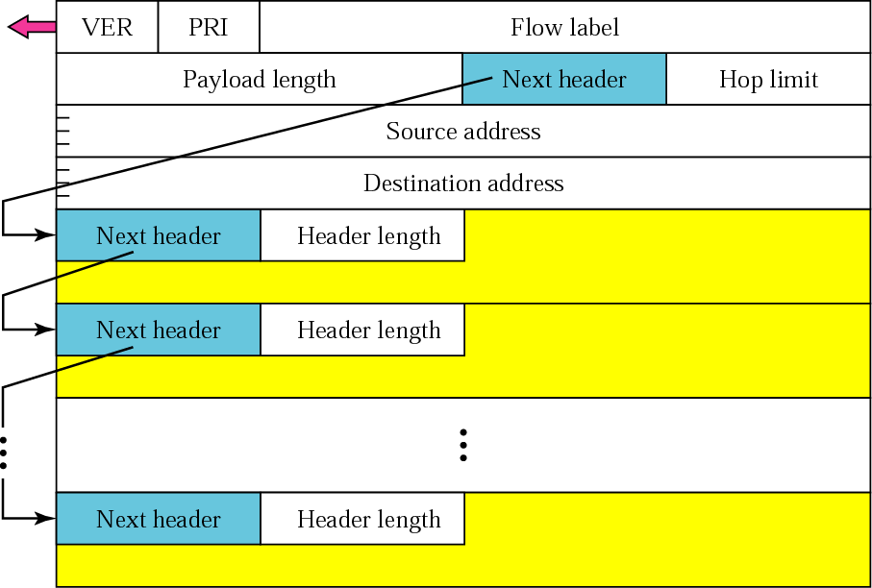
Figure Extension header format
TCP/IP Protocol Suite

Slide 19
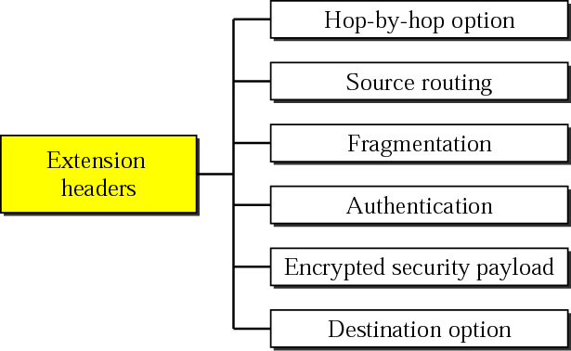
Figure Extension header types
TCP/IP Protocol Suite

Slide 20
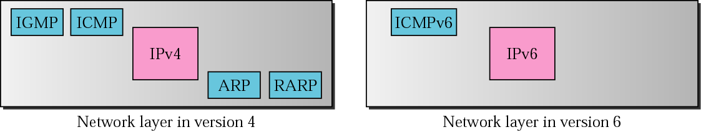
ICMPv6
ICMPv6, while similar in strategy to ICMPv4, has changes that makes it more suitable for IPv6. ICMPv6 has absorbed some protocols that were independent in version 4.
Figure Comparison of network layers in version 4 and version 6
TCP/IP Protocol Suite

Slide 21
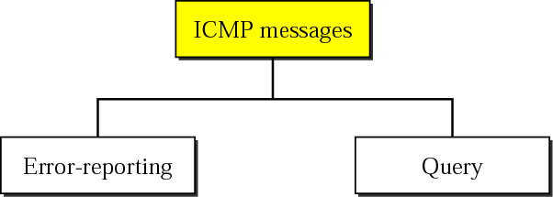
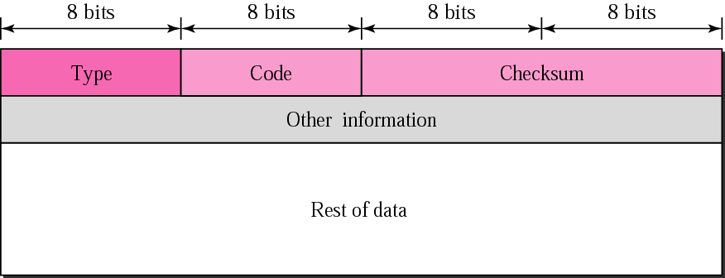
Figure Categories of ICMPv6 messages
Figure General format of ICMP messages
TCP/IP Protocol Suite

Slide 22
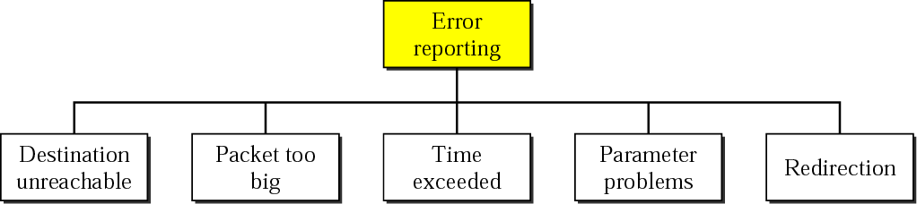
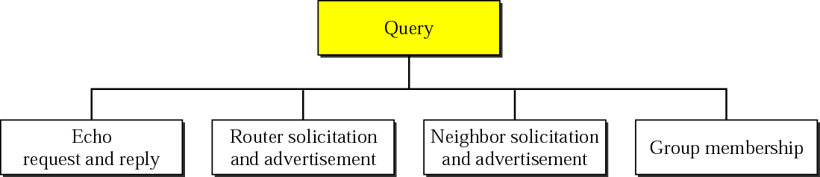
Figure Error-reporting messages
Figure Query messages
TCP/IP Protocol Suite

Slide 23
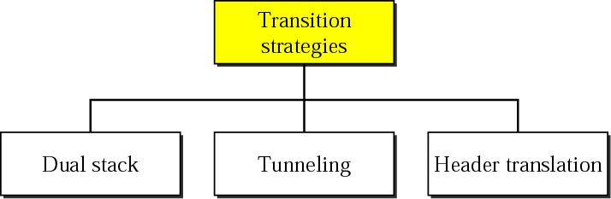
TRANSITION FROM IPv4
TO IPv6
Three strategies have been devised by the IETF to provide for a smooth transition from IPv4 to IPv6.
TCP/IP Protocol Suite

Slide 24
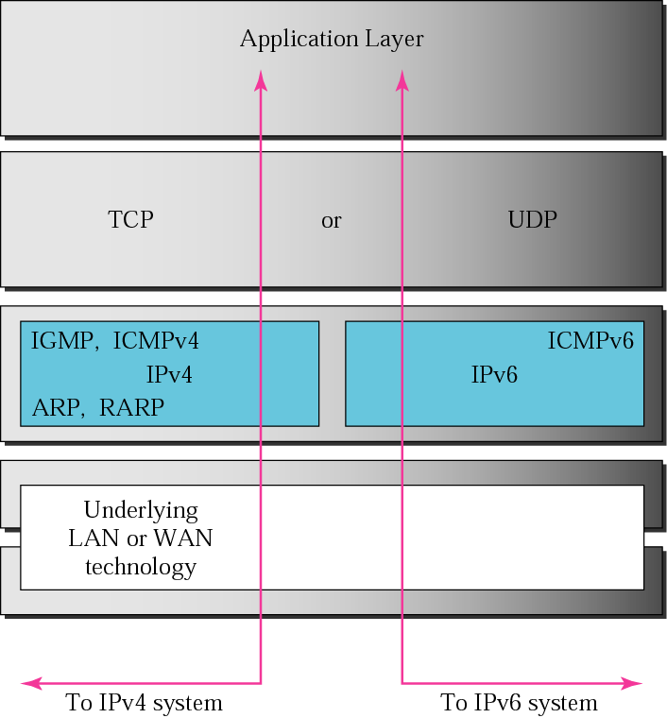
Figure Dual stack
TCP/IP Protocol Suite

Slide 25
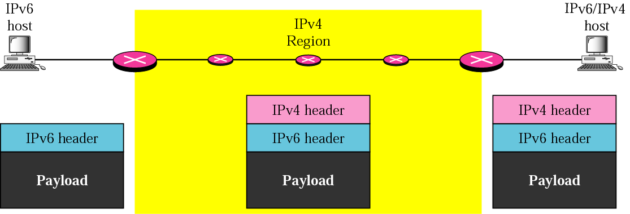
Figure Automatic tunneling
TCP/IP Protocol Suite

Slide 26
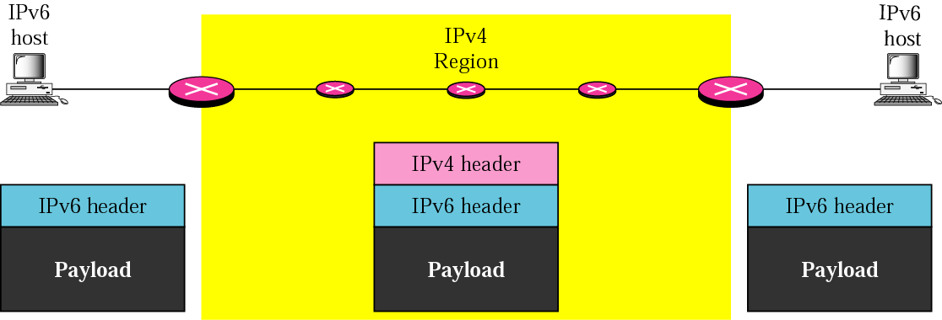
Figure Configured tunneling
TCP/IP Protocol Suite

Slide 27
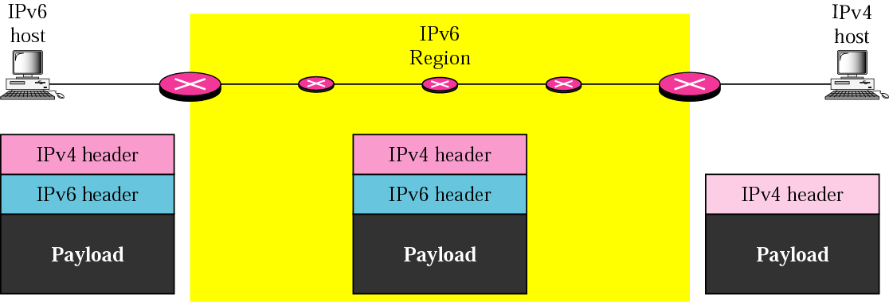
Figure Header translation
TCP/IP Protocol Suite

